Slide 1


International Economics: Theory and Policy
Twelfth Edition
Chapter 22
Developing Countries: Growth, Crisis, and Reform
Copyright © 2022, 2018, 2015 Pearson Education, Inc. All Rights Reserved
Notes:
If this PowerPoint presentation contains mathematical equations, you may need to check that your computer has the following installed:
1) MathType Plugin
2) Math Player (free versions available)
3) NVDA Reader (free versions available)
Slides in this presentation contain hyperlinks. JAWS users should be able to get a list of links by using INSERT+F7

Slide 2
Learning Objectives
22.1 Describe the persistently unequal world distribution of income and the evidence on its causes.
22.2 Summarize the major economic features of developing countries.
22.3 Explain the position of developing countries in the world capital market and the problem of default by developing borrowers.
22.4 Recount the recent history of developing-country financial crises.
22.5 Discuss proposed measures to enhance poorer countries’ gains from participation in the world capital market

Slide 3
Preview
Snapshots of rich and poor countries
Characteristics of poor countries
Borrowing and debt in poor and middle-income economies
The problem of “original sin”
Types of financial assets
Latin American, East Asian, and Russian crises
Currency boards and dollarization
Lessons from crises and potential reforms
Geography’s and human capital’s role in poverty

Slide 4
The Gap Between Rich and Poor
Low income: most sub-Saharan Africa, India, Pakistan
Lower-middle income: China, Caribbean countries
Upper-middle income: Brazil, Mexico, Saudi Arabia, Malaysia, South Africa, Czech Republic
High income: United States, Singapore, France, Japan, Kuwait

Slide 5
Table 22.1 Indicators of Economic Welfare in Four Groups of Countries
Income Group | G D P per Capita (2019 U.S. dollars) | Life Expectancy in 2018 (years)
Low-income | 780 | 63
Lower middle-income | 2,177 | 68
Upper middle-income | 9,040 | 75
High-income | 44,584 | 81
Source: World Bank, World Development Indicators.

Slide 6
Has the World Income Gap Narrowed Over Time?
While some previously middle- and low-income economies have grown faster than high-income countries, and thus have “caught up” with high-income countries, others have languished.
The income levels of high-income countries and some previously middle-income and low-income countries have converged.
But the some of the poorest countries have had the lowest growth rates.

Slide 7
Table 22.2 Output per Capita in Selected Countries, 1960–2017 (in 2011 U.S. Dollars) (1 of 4)
Industrialized in 1960
Country | Output per Capita 1960 | Output per Capita 2017 | 1960–2017 Annual Average Growth Rate (percent per year)
Canada | 15,573 | 44,975 | 1.9
France | 11,344 | 38,170 | 2.2
Germany | 13,337 | 46,349 | 2.2
Italy | 10,176 | 35,668 | 2.2
Japan | 6,400 | 39,381 | 3.2
Spain | 7,301 | 33,593 | 2.7
Sweden | 14,478 | 45,844 | 2.0
United Kingdom | 12,719 | 38,153 | 1.9
United States | 17,319 | 54,586 | 2.0

Slide 8
Table 22.2 Output per Capita in Selected Countries, 1960–2017 (in 2011 U.S. Dollars) (2 of 4)
Africa
Country | Output per Capita 1960 | Output per Capita 2017 | 1960–2017 Annual Average Growth Rate (percent per year)
Kenya | 1,952 | 3,090 | 0.8
Nigeria | 2.665 | 5,270 | 1.2
Senegal | 2.917 | 3,111 | 0.1
South Africa | 7,204 | 12,004 | 0.9
Zimbabwe | 1,132 | 1,914 | 0.9

Slide 9
Table 22.2 Output per Capita in Selected Countries, 1960–2017 (in 2011 U.S. Dollars) (3 of 4)
Latin America
Country | Output per Capita 1960 | Output per Capita 2017 | 1960–2017 Annual Average Growth Rate (percent per year)
Argentina | 9,283 | 16,432 | 1.0
Brazil | 3,995 | 14,066 | 2.2
Chile | 5,734 | 22,123 | 2.4
Colombia | 4,059 | 13,585 | 2.1
Costa Rica | 4,329 | 14,712 | 2.2
Mexico | 6,633 | 16,792 | 1.6
Paraguay | 2,618 | 8,948 | 2.2
Peru | 5,135 | 11,808 | 1.5
Venezuela | 11,935 | 11,321 | negative 0.1

Slide 10
Table 22.2 Output per Capita in Selected Countries, 1960–2017 (in 2011 U.S. Dollars) (4 of 4)
Asia
Country | Output per Capita 1960 | Output per Capita 2017 | 1960–2017 Annual Average Growth Rate (percent per year)
China | 815 | 13,465 | 5.0
Hong Kong | 4,459 | 50,271 | 4.3
India | 1,048 | 6,548 | 3.3
Indonesia | 1,635 | 11,173 | 3.4
Malaysia | 2,639 | 24,574 | 4.0
Singapore | 4,368 | 69,150 | 5.0
South Korea | 1,573 | 36,999 | 5.7
Taiwan | 2,070 | 43,501 | 5.5
Thailand | 1,162 | 14,884 | 4.7
Note: Data are taken from the Penn World Table, Version 9.1, and use P P P exchange rates to compare national incomes
(variables R G D P N A/P O P). For a description, see the Penn World Table website at
https://www.rug.nl/ggdc/productivity/pwt/
.

Slide 11
Structural Features of Developing Countries (1 of 5)
What causes poverty is a difficult question, but low-income countries have at least some of following characteristics, which could contribute to poverty:
Government control of the economy
Restrictions on trade
Direct control of production in industries and a high level of government purchases relative to G N P
Direct control of financial transactions
Reduced competition reduces innovation; lack of market prices prevents efficient allocation of resources

Slide 12
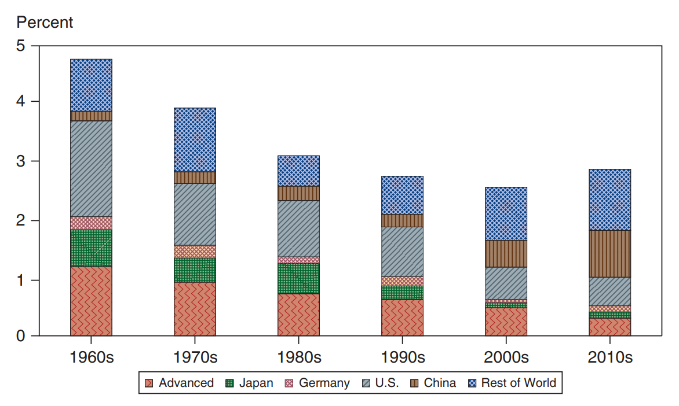
Figure 22.1 Richer Countries Have Become Less Important for Global G D P Growth
As many developing countries have grown more quickly and come to account for larger shares of world output, their G D P growth rates have become more important in determining overall world growth. At the same time, growth in the richer economies has tended to slow over time.
Source: I M F, World Economic Outlook. The group of “advanced economies” in the chart excludes Japan, Germany, and United States, which are shown separately. World growth is calculated using G D P weights, with G D P measured at market prices. Partial data for the 2010s.
Notes:
The following list provides rates for advanced countries, Japan, Germany, the U S, China, and the rest of the world. The rates for the 19 sixties are as follows. Advanced countries, 1.2, Japan, 0.6, Germany, 0.2, U S, 3.7, China, 0.1, rest of the world, 1.0, for a global growth rate of 4.8. In the 19 nineties, the global rate drops to 2.9 with the following rates, advanced countries, 0.7, Japan, 0.2, Germany, 0.1, U S, 0.9, China, 0.2, rest of the world, 0.6, for a global growth rate of roughly 2.8. In the 20 tens, the global rate has grown slightly with the following rates. Advanced countries, 0.3, Japan, 0.05, Germany, 0.05, U S, 0.5, China, 0.9, rest of the world, 1.1, for a global growth rate of roughly 3.1. All values are estimated.

Slide 13
Structural Features of Developing Countries (2 of 5)
Unsustainable macroeconomic policies that cause high inflation and unstable output and employment
If governments cannot pay for debts through taxes, they can print money to finance debts.
Seigniorage is paying for real goods and services by printing money.
Seigniorage generally leads to high inflation.
High inflation reduces the real cost of debt that the government has to repay and reduces the real value of repayments for lenders.
High and variable inflation is costly to society; unstable output and employment is also costly.

Slide 14
Structural Features of Developing Countries (3 of 5)
Lack of financial markets that allow transfer of funds from savers to borrowers
Banks frequently lend funds to poor or risky projects.
Loans may be made on the basis of personal connections rather than prospective returns, and government safeguards against financial fragility, such as bank supervision, tend to be ineffective due to incompetence, inexperience, and outright fraud.
Usually harder in developing countries for shareholders to find out how a firm’s money is being spent or to control firm managers.
The legal framework for resolving asset ownership in cases of bankruptcy typically is also weak.

Slide 15
Structural Features of Developing Countries (4 of 5)
Where exchange rates are not pegged outright (as in China), they tend to be managed more heavily by developing-country governments. Government measures to limit exchange rate flexibility reflect both a desire to keep inflation under control and the fear that floating exchange rates would be subject to huge volatility in the relatively thin markets for developing-country currencies. There is a history of allocating foreign exchange through government decree rather than through the market, a practice (called exchange control) that some developing countries still maintain. Most developing countries have, in particular, tried to control capital movements by limiting foreign exchange transactions connected with trade in assets. More recently, however, many emerging markets have opened their capital accounts.

Slide 16
Structural Features of Developing Countries (5 of 5)
Natural resources or agricultural commodities make up an important share of exports for many developing countries.
For example, Russian petroleum, Malaysian timber, South African gold, and Colombian coffee.
Attempts to circumvent government controls, taxes, and regulations have helped to make corrupt practices such as bribery and extortion a way of life in many developing countries.
Due to government control of the economy and weak enforcement of economic laws and regulations, underground economies and corruption flourish.

Slide 17
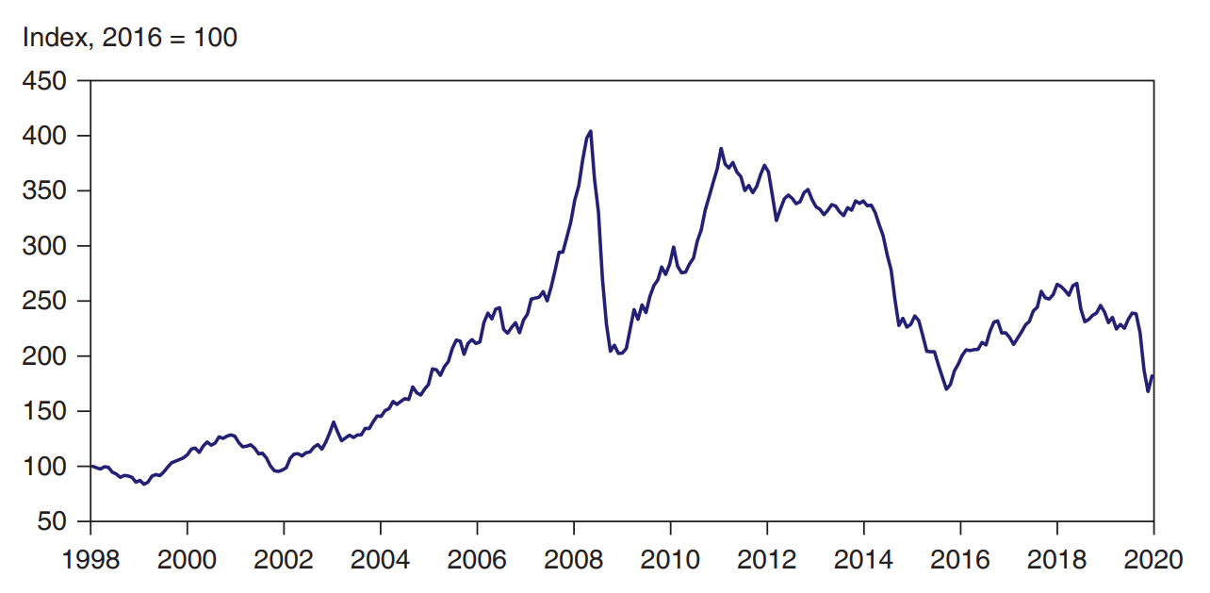
Commodity Price Index
Over the past two decades, aggregate commodity prices have experienced a boom-bust cycle.
Source: I M F. All Commodity Price Index (2016 = 100). Includes both fuel and non-fuel indices.
Notes:
The plot for commodity price index generally rises from (19 98, 100) to (2008, 430) and then drops steeply to (2009, 175) before generally rising again to (20 13, 350). The plot then generally falls through (20 14, 360) to (20 16, 200). All values are estimated.

Slide 18
Figure 22.2 Corruption and Per Capita Output
Corruption tends to rise as real per capita output falls.
Note: The figure plots 2018 values of an (inverse) index of corruption and 2018 values of PPP-adjusted real per capita output, measured in constant 2010 U.S. dollars (the amount a dollar could buy in the United States in 2010). The straight line represents a statistician’s best guess of a country’s corruption level based on its real per capita output.
Source: Transparency International, Corruption Perception Index; World Bank, World Development Indicators.
Notes:
A scatter diagram plots inverse index of corruption, cleanest = 10, versus annual per capital 20 18 output in 20 10 U S dollars. A regression line rises from (0, 3.25) through (40,000, 6.4) to (80,000, 10). Most data points are clustered between (5,000, 2) and (10,000, 4). The U S is noted as (52,000, 7.2), partially overlapping the regression line. 2 outliers are between roughly (95,000, 8.5) and (10,300, 8). All values are estimated.

Slide 19
Developing-Country Borrowing and Debt
Another common characteristic for many low- and middle-income countries is that they have traditionally borrowed from foreign countries.
Financial asset flows from foreign countries are able to finance investment projects, eventually leading to higher production and consumption.
But some investment projects fail and other borrowed funds are used primarily for consumption purposes.
Some countries have defaulted on their foreign debts when the domestic economy stagnated or during financial crises.
But this trend has recently reversed as these countries have begun to save.

Slide 20
The Economics of Financial Inflows to Developing Countries
where the current account is approximately equal to the value of exports minus the value of imports.
Countries with national saving less than domestic investment will have financial asset inflows and a negative current account (a trade deficit).

Slide 21
Table 22.3 Cumulative Current Account Balances of Major Oil Exporters, Other Developing Countries, and Advanced Countries, 1973–2019 (Billions of Dollars)
Blank | Major Oil Exporters | Other Developing Countries | Advanced Countries
1973–1981 | 253 | negative 246 | negative 184
1982–1989 | negative 65 | negative 143 | negative 427
1990–1998 | negative 58 | negative 523 | negative 106
1999–2019 | 5,313 | negative 852 | negative 758
Source: International Monetary Fund, International Financial Statistics and World Economic Outlook data. Global current accounts generally do not sum to zero because of errors, omissions, and the exclusion of some countries in some periods.

Slide 22
The Problem of Default (1 of 6)
A financial crisis may involve
a debt crisis: an inability to repay sovereign (government) or private sector debt.
a balance of payments crisis under a fixed exchange rate system.
a banking crisis: bankruptcy and other problems for private sector banks.

Slide 23
The Problem of Default (2 of 6)
A debt crisis in which governments default on their debt can be a self-fulfilling mechanism.
Fear of default reduces financial asset inflows and increases financial asset outflows (capital flight), decreasing investment and increasing interest rates, leading to low aggregate demand, output, and income.
Financial asset outflows must be matched with an increase in net exports or a decrease in official international reserves in order to pay individuals and institutions who desire foreign funds.

Slide 24
The Problem of Default (3 of 6)
Otherwise, the country cannot afford to pay those who want to remove their funds from the domestic economy.
The domestic government may have no choice but to default on its sovereign debt (paid for with foreign funds) when it comes due and when investors are unwilling to reinvest.

Slide 25
The Problem of Default (4 of 6)
In general, a debt crisis can quickly magnify itself: it causes low income and high interest rates, which make government and private sector debts even harder to repay.
High interest rates cause high interest payments for both the government and the private sector.
Low income causes low tax revenue for the government.
Low income makes loans made by private banks harder to repay: the default rate increases, which may cause bankruptcy.

Slide 26
The Problem of Default (5 of 6)
If the central bank tries to fix the exchange rate, a balance of payment crisis may result along with a debt crisis.
Official international reserves may quickly be depleted because governments and private institutions need to pay for their debts with foreign funds, forcing the central bank to abandon the fixed exchange rate.
A banking crisis may result from a debt crisis.
High default rates on loans made by banks reduce their income to pay for liabilities and may increase bankruptcy.
If depositors fear bankruptcy due to possible devaluation of the currency or default on government debt (assets for banks), then they will quickly withdraw funds from banks (and possibly purchase foreign assets), leading to actual bankruptcy.

Slide 27
The Problem of Default (6 of 6)
A debt crisis, a balance of payments crisis, and a banking crisis can occur together, and each can make the other worse.
Each can cause aggregate demand, output, and employment to fall (further).
If people expect a default on sovereign debt, a currency devaluation, or bankruptcy of private banks, each can occur, and each can lead to another.

Slide 28
Alternative Forms of Financial Inflow (1 of 3)
Bond finance: government or private sector bonds are sold to foreign individuals and institutions.
Bank finance: commercial banks or securities firms lend to foreign governments or foreign businesses.
Official lending: the World Bank, Inter-American Development Bank, or other official agencies lend to governments.
Sometimes these loans are made on a “concessional” or favorable basis, in which the interest rate is low.

Slide 29
Alternative Forms of Financial Inflow (2 of 3)
Foreign direct investment: a firm directly acquires or expands operations in a subsidiary firm in a foreign country.
A purchase by Ford of a subsidiary firm in Mexico is classified as foreign direct investment.
Portfolio equity investment: a foreign investor purchases equity (stock) for his portfolio.
Privatization of government-owned firms in many countries has created more equity investment opportunities for foreign investors.

Slide 30
Alternative Forms of Financial Inflow (3 of 3)
Debt finance includes bond finance, bank finance, and official lending.
Equity finance includes direct investment and portfolio equity investment.
While debt finance requires fixed payments regardless of the state of the economy, the value of equity finance fluctuates depending on aggregate demand and output.

Slide 31
The Problem of “Original Sin” (1 of 4)
Sovereign and private sector debts in the United States, Japan, and European countries are mostly denominated in their respective currencies.
But when poor and middle-income countries borrow in international financial capital markets, their debts are almost always denominated in U S $, yen, or euros: a condition called “original sin.”

Slide 32
The Problem of “Original Sin” (2 of 4)
When a depreciation of domestic currencies occurs in the United States, Japan, or European countries, liabilities (debt) that are denominated in domestic currencies do not increase, but the value of foreign assets increases.
A devaluation of the domestic currency causes an increase in net foreign wealth.

Slide 33
The Problem of “Original Sin” (3 of 4)
When a depreciation/devaluation of domestic currencies occurs in most poor and middle-income economies, the value of their liabilities (debt) rises because their liabilities are denominated in foreign currencies.
A devaluation of the domestic currency causes a decrease in net foreign wealth.

Slide 34
The Problem of “Original Sin” (4 of 4)
In particular, a fall in aggregate demand of domestic products causes a depreciation/devaluation of the domestic currency and causes a decrease in net foreign wealth if assets are denominated in domestic currencies and liabilities (debt) are denominated in foreign currencies.
This is a situation of “negative insurance” against a fall in aggregate demand.

Slide 35
The Debt Crisis of the 1980s (1 of 2)
In the 1980s, high interest rates and an appreciation of the U.S. dollar caused the burden of dollar-denominated debts in Argentina, Mexico, Brazil, and Chile to increase drastically.
A worldwide recession and a fall in many commodity prices also hurt export sectors in these countries.
In August 1982, Mexico announced that it could not repay its debts, mostly to private banks.

Slide 36
The Debt Crisis of the 1980s (2 of 2)
The U.S. government insisted that the private banks reschedule the debts, and in 1989 Mexico was able to achieve
a reduction in the interest rate
an extension of the repayment period
a reduction in the principal by 12%
Brazil, Argentina, and other countries were also allowed to reschedule their debts with private banks after they defaulted.

Slide 37
Reforms, Capital Inflows, and the Return of Crisis (1 of 9)
The Mexican government implemented several reforms due to the crisis. Starting in 1987, it
reduced government deficits.
reduced production in the public sector (including banking) by privatizing industries.
reduced barriers to trade.
maintained an adjustable fixed exchange rate (“crawling peg”) until 1994 to help curb inflation.

Slide 38
Reforms, Capital Inflows, and the Return of Crisis (2 of 9)
It extended credit to newly privatized banks with loan losses.
Losses were a problem due to weak enforcement or lack of asset restrictions and capital requirements.
Political instability and loan defaults at private banks contributed to another crisis in 1994, after which the Mexican government allowed the value of the peso to fluctuate.

Slide 39
Reforms, Capital Inflows, and the Return of Crisis (3 of 9)
Starting in 1991, Argentina carried out similar reforms:
It reduced government deficits.
It reduced production in the public sector by privatizing industries.
It reduced barriers to trade.
It enacted tax reforms to increase tax revenues.
It enacted the Convertibility Law, which required that each peso be backed with 1 U.S. dollar, and it fixed the exchange rate to 1 peso per U.S. dollar.

Slide 40
Reforms, Capital Inflows, and the Return of Crisis (4 of 9)
Because the central bank was not allowed to print more pesos without having more dollar reserves, inflation slowed dramatically.
Yet inflation was about 5% per annum, faster than U.S. inflation, so that the price/value of Argentinean goods appreciated relative to U.S. and other foreign goods.
Due to the relatively rapid peso price increases, markets began to speculate about a peso devaluation.
A global recession in 2001 further reduced the demand of Argentinean goods and currency.

Slide 41
Reforms, Capital Inflows, and the Return of Crisis (5 of 9)
Maintaining the fixed exchange rate was costly because high interest rates were needed to attract investors, further reducing investment and consumption expenditure, output, and employment.
As incomes fell, tax revenues fell and government spending rose, contributing to further peso inflation.

Slide 42
Reforms, Capital Inflows, and the Return of Crisis (6 of 9)
Argentina tried to uphold the fixed exchange rate, but the government devalued the peso in 2001 and shortly thereafter allowed its value to fluctuate.
It also defaulted on its debt in December 2001 because of the unwillingness of investors to reinvest when the debt was due.

Slide 43
Reforms, Capital Inflows, and the Return of Crisis (7 of 9)
Brazil carried out similar reforms in the 1980s and 1990s:
It reduced production in the public sector by privatizing industries.
It reduced barriers to trade.
It enacted tax reforms to increase tax revenues.
It fixed the exchange rate to 1 real per U.S. dollar.
But government deficits remained high.

Slide 44
Reforms, Capital Inflows, and the Return of Crisis (8 of 9)
High government deficits led to inflation and speculation about a devaluation of the real.
The government did devalue the real in 1999, but a widespread banking crisis was avoided because Brazilian banks and firms did not borrow extensively in dollar-denominated assets.

Slide 45
Reforms, Capital Inflows, and the Return of Crisis (9 of 9)
Chile suffered a recession and financial crisis in the 1980s, but thereafter
enacted stringent financial regulations for banks.
removed the guarantee from the central bank that private banks would be bailed out if their loans failed.
imposed controls on flows of short-term assets, so that funds could not be quickly withdrawn during a financial panic.
granted the central bank independence from fiscal authorities, allowing slower money supply growth.
Chile avoided a financial crisis in the 1990s.

Slide 46
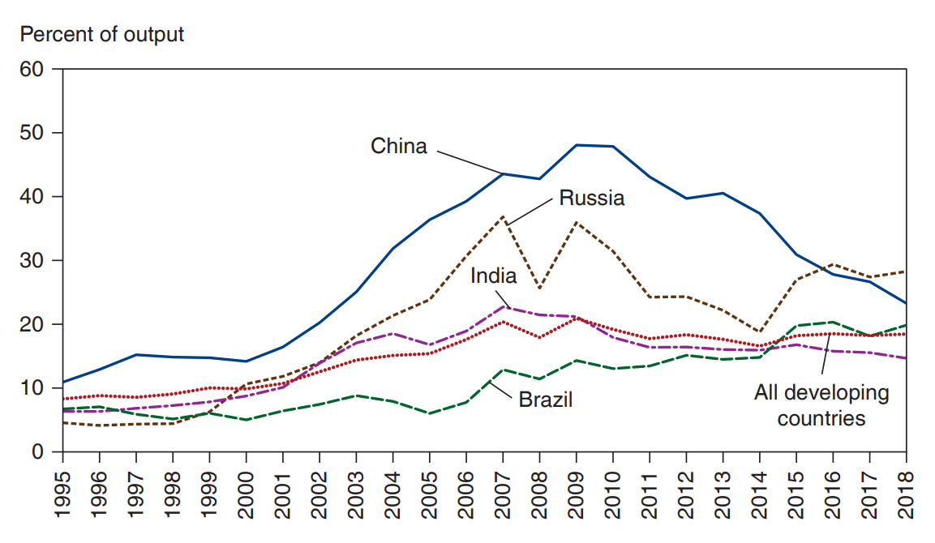
International Reserves Held by Developing Countries
Since the 1990s, developing countries have sharply increased their holdings of foreign currency reserves, mostly U.S. dollars.
Source: World Bank, World Development indicators. In this chart, developing countries include low- and middle-income countries according to the World Bank’s country income classification.
Notes:
The graph plots percent of output versus year, 19 96 to 20 15. There are 5 plots, for Brazil, India, all developing countries, Russia, and China. The plot for Brazil generally rises from (19 95, 7) through (2007, 14) to (20 15, 20). The plot for India generally rises from (19 95, 7) to (2007, 23) and then generally falls to (20 15, 16). The plot for all developing countries generally rises from (19 95, 8) to (2009, 30) and then falls to (20 15, 24). The plot for Russia generally rises from (19 95, 4) to (2007, 37), dips to (2008, 26), rises again to (2009, 36), and then generally falls to (20 15, 24). The plot for China generally rises from (19 95, 11) to (2009, 48) and then generally falls to (20 15, 32). All values are estimated.

Slide 47
East Asia: Success and Crisis (1 of 2)
Before the 1990s, Indonesia, Korea, Malaysia, Philippines, and Thailand relied mostly on domestic saving to finance investment.
But afterward, foreign funds financed much of investment, and current account balances turned negative.

Slide 48
East Asia: Success and Crisis (2 of 2)
Despite the rapid economic growth in East Asia between 1960 and 1997, growth was predicted to slow as economies “caught up” with Western countries.
Most of the East Asian growth during this period is attributed to an increase in physical capital and education.
The marginal productivities of physical capital and education are diminishing: as more physical capital was built and as more people acquired more education, further increases added less productive capability to the economy.

Slide 49
The Asian Financial Crises (1 of 6)
More directly related to the East Asian crises are issues related to economic laws and regulations:
Weak enforcement of financial regulations and a lack of monitoring caused commercial firms, banks, and borrowers to engage in risky or even fraudulent activities: moral hazard.
Ties between commercial firms and banks on the one hand and government regulators on the other hand allowed risky investments to occur.

Slide 50
The Asian Financial Crises (2 of 6)
Nonexistent or weakly enforced bankruptcy laws and loan contracts worsened problems after the crisis started.
Financially troubled firms stopped paying their debts, and they could not operate without cash, but no one would lend more until previous debts were paid.
But creditors lacked the legal means to confiscate and sell assets to other investors or to restructure the firms to make them productive again.

Slide 51
The Asian Financial Crises (3 of 6)
The East Asian crisis started in Thailand in 1997, but quickly spread to other countries.
A fall in real estate prices, and then stock prices, weakened aggregate demand and output in Thailand.
A fall in aggregate demand in Japan, a major investor and export market, also contributed to the economic slowdown.
Speculation about a devaluation of the baht occurred, and in July 1997 the government devalued the baht slightly, but this only invited further speculation.
Malaysia, Indonesia, Korea, and the Philippines soon faced speculations about the value of their currencies.

Slide 52
The Asian Financial Crises (4 of 6)
Most debts of banks and firms were denominated in U.S. dollars, so that devaluations of domestic currencies would make the burden of the debts in domestic currency increase.
Bankruptcy and a banking crisis would have resulted.
To maintain fixed exchange rates would have required high interest rates and a reduction in government deficits, leading to a reduction in aggregate demand, output, and employment.
This would have also led to widespread default on debts and a banking crisis.

Slide 53
The Asian Financial Crises (5 of 6)
All of the affected economies except Malaysia turned to the I M F for loans to address the balance of payments crises and to maintain the value of the domestic currencies.
The loans were conditional on increased interest rates (reduced money supply growth), reduced budget deficits, and reforms in banking regulation and bankruptcy laws.
Malaysia instead imposed controls on flows of financial assets so that it could increase its money supply (and lower interest rates), increase government purchases, and still try to maintain the value of the ringgit.

Slide 54
The Asian Financial Crises (6 of 6)
Because consumption and investment expenditure decreased with output, income, and employment, imports fell and the current account increased after 1997.

Slide 55
Lessons of Crises (1 of 4)
Fixing the exchange rate has risks: governments desire to fix exchange rates to provide stability in the export and import sectors, but the price to pay may be high interest rates or high unemployment.
High inflation (caused by government deficits or increases in the money supply) or a drop in demand of domestic exports leads to an overvalued currency and pressure for devaluation.
Given pressure for devaluation, commitment to a fixed exchange rate usually means high interest rates (a reduction in the money supply) and a reduction in domestic prices.

Slide 56
Lessons of Crises (2 of 4)
Prices can be reduced through a reduction in government deficits, leading to a reduction in aggregate demand, output, and employment.
A fixed currency may encourage banks and firms to borrow in foreign currencies, but a devaluation will cause an increase in the burden of this debt and may lead to a banking crisis and bankruptcy.
Commitment a fixed exchange rate can cause a financial crisis to worsen: high interest rates make loans for individuals and institutions harder to repay, and the central bank cannot freely print money to give to troubled banks (cannot act as a lender of last resort).

Slide 57
Lessons of Crises (3 of 4)
Weak enforcement of financial regulations can lead to risky investments and a banking crisis when a currency crisis erupts or when a fall in output, income, and employment occurs.
Liberalizing financial asset flows without implementing sound financial regulations can lead to capital flight when investments lose value during a recession.

Slide 58
Lessons of Crises (4 of 4)
The importance of expectations: even healthy economies are vulnerable to crises when expectations change.
Expectations about an economy often change when other economies suffer from adverse events.
International crises may result from contagion: an adverse event in one country leads to a similar event in other countries.

Slide 59
Reforming the World’s Financial “Architecture” (1 of 3)
Countries face tradeoffs when trying to achieve the following goals:
exchange rate stability
financial capital mobility
autonomous monetary policy devoted to domestic goals
Generally, countries can attain only two of the three goals, and as financial assets have become more mobile, maintaining a fixed exchange with an autonomous monetary policy has been difficult.

Slide 60
Reforming the World’s Financial “Architecture” (2 of 3)
Preventative (“prophylactic”) measures:
Better monitoring and more transparency: more information allows investors to make sound financial decisions in good and bad times.
Stronger enforcement of financial regulations: reduces moral hazard.
Deposit insurance and reserve requirements.
Increased equity finance relative to debt finance.
Increased credit for troubled banks through central banks or the I M F?

Slide 61
Reforming the World’s Financial “Architecture” (3 of 3)
Coping with crisis—reforms for after a crisis occurs:
Bankruptcy procedures for default on sovereign debt and improved bankruptcy law for private sector debt.
A bigger or smaller role for the I M F as a lender of last resort for governments, central banks, and even the private sector? (See 5 above.)
Moral hazard versus the benefit of insurance before and after a crisis occurs.

Slide 62
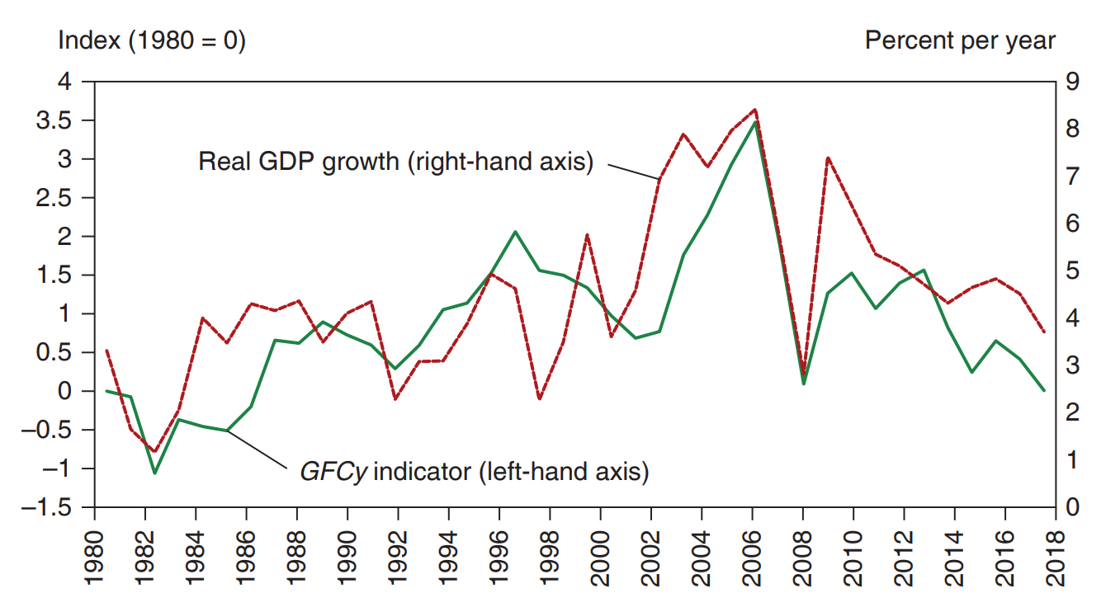
Global Financial Cycles and Movements in the Developing World’s G D P
The G D P growth rate of poorer countries moves closely in tandem with the global financial cycle.
Source: G F C y: Miranda-Agrippino and Rey. “U.S. Monetary Policy and the Global Financial Cycle,” Review of Economic Studies 87 (2020). Yearly observations on G F C y are averages of monthly observations. G D P growth in emerging and developing economies: World Economic Outlook database, April 2020.
Notes:
The plot for real G D P growth versus percent per year falls from (19 80, 3) to (19 82, 1), (19 91, 4), (19 99, 2), (2006, 8), (2008, 3), (20 10, 7), (20 18, 4). The plot for C y indicator versus index falls from (19 80, 0) to (19 82, negative 1), (19 92, 0.5), (19 99, 2), (2002, 1), (2006, 3.5), (2008, 0), (20 14, 1.5), (20 18, 0). All values are estimated.

Slide 63
Geography, Human Capital, and Institutions (1 of 4)
What causes poverty?
A difficult question: economists argue about whether geography or human capital is more important in influencing economic and political institutions, and ultimately poverty.

Slide 64
Geography, Human Capital, and Institutions (2 of 4)
Geography matters:
International trade is important for growth, and ocean harbors and a lack of geographical barriers foster trade with foreign markets.
Landlocked and mountainous regions are predicted to be poor.
Also, geography is said to have determined institutions, which may play a role in development.
Geography determined whether Westerners established property rights and long-term investment in colonies, which in turn influenced economic growth.

Slide 65
Geography, Human Capital, and Institutions (3 of 4)
Geography determined whether Westerners died from malaria and other diseases. With high mortality rates, they established practices and institutions based on quick plunder of colonies’ resources, rather than institutions favoring long-term economic growth.
Plunder led to property confiscation and corruption, even after political independence from Westerners.
Geography also determined whether local economies were better for plantation agriculture, which resulted in income inequalities and political inequalities. Under this system, equal property rights were not established, hindering long-term economic growth.

Slide 66
Geography, Human Capital, and Institutions (4 of 4)
Human capital matters:
As a population becomes more literate, numerate, and educated, economic and political institutions evolve to foster long-term economic growth.
Rather than geography, Western colonization, and plantation agriculture, the amount of education and other forms of human capital determine the existence or lack of property rights, financial markets, international trade, and other institutions that encourage economic growth.

Slide 67
Summary (1 of 3)
Some countries have grown rapidly since 1960, but others have stagnated and remained poor.
Many poor countries have extensive government control of the economy, unsustainable fiscal and monetary policies, lack of financial markets, weak enforcement of economic laws, a large amount of corruption, and low levels of education.
Many developing economies have traditionally borrowed from international capital markets, and some have suffered from periodic sovereign debt crises, balance of payments crises, and banking crises.

Slide 68
Summary (2 of 3)
Sovereign debt, balance of payments, and banking crises can be self-fulfilling, and each crisis can lead to another within a country or in another country.
“Original sin” refers to the fact that poor and middle- income countries often cannot borrow in their domestic currencies.
Fixing exchange rates may lead to financial crises if the country is unwilling to restrict monetary and fiscal policies.

Slide 69
Summary (3 of 3)
Fixing exchange rates may lead to financial crises if the country is unwilling to restrict monetary and fiscal policies.
Weak enforcement of financial regulations causes a moral hazard and may lead to a banking crisis, especially with free movement of financial assets.
Geography and human capital may influence economic and political institutions, which in turn may affect long-term economic growth.

Slide 70

Copyright
This work is protected by United States copyright laws and is provided solely for the use of instructors in teaching their courses and assessing student learning. Dissemination or sale of any part of this work (including on the World Wide Web) will destroy the integrity of the work and is not permitted. The work and materials from it should never be made available to students except by instructors using the accompanying text in their classes. All recipients of this work are expected to abide by these restrictions and to honor the intended pedagogical purposes and the needs of other instructors who rely on these materials.

